Slide 1
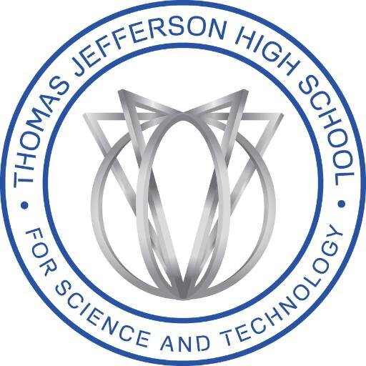
Development of Python-based Toolkit to Improve Analysis of Atom Probe Tomography Data
Vishal Kanigicherla
Science and Technology Department, Thomas Jefferson High School for Science and Technology, Alexandria, VA, USA

Slide 2
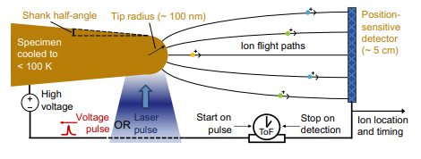
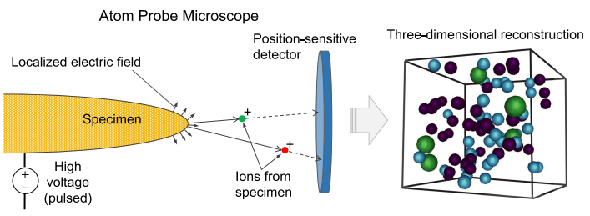
Atom Probe Tomography
Atom-by-atom dissection of a material volume
Sub-nanometer resolution, and chemical sensitivities approaching 10 atomic ppm
Breakdown by field evaporation
Time-of-flight mass spectrometry and impact recordings create reconstruction
Mass-to-charge ratio and (x, y, z) recorded in POS file
Proximity histogram (proxigram) details at% composition of thin ~.1 nm shells of sample about predetermined surface
Figure 1. The schematics above represent the process of atom probe tomography, and demonstrate how reconstructions can be developed from a position-sensitive detector. Image sourced from Reddy, S. M., Saxey, D. W., Rickard, W. D. A., Fougerouse, D., Montalvo, S. D., Verberne, R., & van Riessen, A. (2020).

Slide 3
Literature Review - The Challenges of Atom Probe Tomography
Leaves molecular artifacts in sample through FIB milling and other processing (Tamura, M., Shukuri, S., Moniwa, M., & Default, M. (1986))
Isotopic overlaps left inherent to time-of-flight mass spectrometry
Mass spectrum ranging and peak identification is difficult
Maximum separation algorithm heavily dependent on user-input parameters, could use optimization (Vincent, G. B., Proudian, A. P., & Zimmerman, J. D. (2020))
Lack of algorithms to calculate error statistics and relevant thermodynamic quantities such as Gibbs interfacial excess of solute for which APT is easily applicable (Hellman, O. C., & Seidman, D. N. (2002), Krakauer, B. W., & Seidman, D. N. (1993))
Large amounts of data make processing generally tedious - optimization and automation of the process is a viable direction for development

Slide 4
Project Direction
This project seeks to holistically address APT data analysis using Python, liberating APT data analysis from proprietary software while also improving existing data analysis techniques by implementing various algorithms employing optimization and machine learning. This project is trying to test the extent to which established techniques are user-friendly, accessible, and optimized.

Slide 5

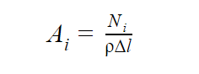
Gibbsian Interfacial Excess of Solute
Γs, concentration of solute within an infinitesimally small interface, a “Gibbs dividing surface,” between two bulk phases of a material
Atom probe proxigram data is very well suited for this calculation, already binned shells
Prior formulations require knowledge of area of shell thickness, possible to bypass
Circumvented a priori requisites for ⍴ using lattice parameter of molecular species and assumption of Bravais crystal lattice structure
Figure 2. Hellman & Seidman (2002) determined the above formulations that eliminated the need for a priori knowledge of slice area, and through dimensional analysis substituted a formula

Slide 6
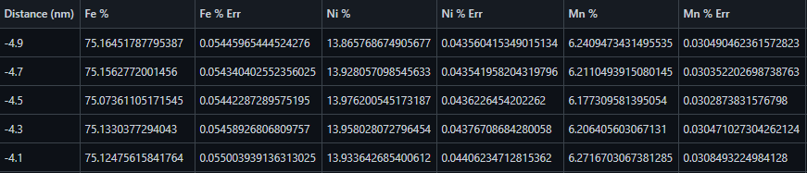
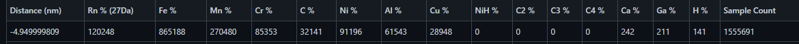
Manipulation of Proxigram .csv and Raw Data .pos and .epos Files
.pos files are binary files including x, y, z position data and mass-to-charge ratio
.epos files are extended .pos files with 11 attributes instead of 4
Proxigrams are .csv files which note atom counts of individual species in ~.1 nm shells shells at specific proximities from an interface
Figure 3. Modified proxigram at% .csv file including spatial error calculations for plotting proxigram profile.
Figure 4. Unmodified proxigram of atom counts. Note Rn % (27Da), raw data for the 27 Dalton which could be 27Al¹⁺, 54Fe²⁺, or 54Cr²⁺. This ambiguity of isotopic overlap requires further resolution, one of the tasks executed by the toolkit.

Slide 7
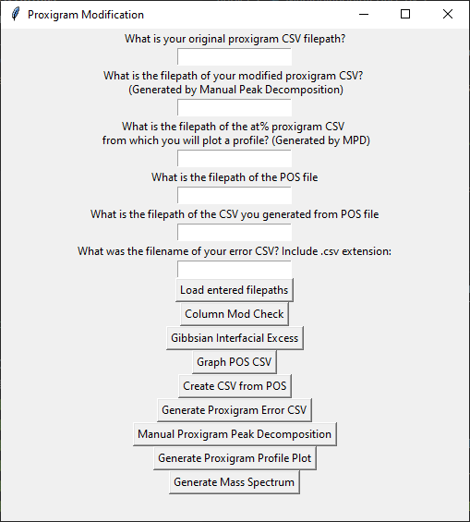
Programs and Dependencies
Python code was written in order to:
Generate initial CSV files from proxigram XLSX.
Take user-input for manual peak decomposition in proxigrams.
Convert proxigram atom counts to at% values.
Generate profiles of proxigram data after discarding irrelevant isotopes.
Create core statistics file from user identification of matrix and precipitate of profile.
Turn large POS files into workable CSVs.
Calculate and display spatial error statistics for proxigram and CSV.
Take inputs for calculating average radius, vol fraction, and number density, do the calculation, and report the uncertainty.
Generate a mass spectrum graph and analysis from POS CSV.
Consolidate programs into GUI using Py2App and tkinter for better user experience.
Figure 5. Image of user interface application with integrated programs. Packages used in this project and thus system requirements are struct, pandas, tkinter, numpy, and matplotlib.

Slide 8
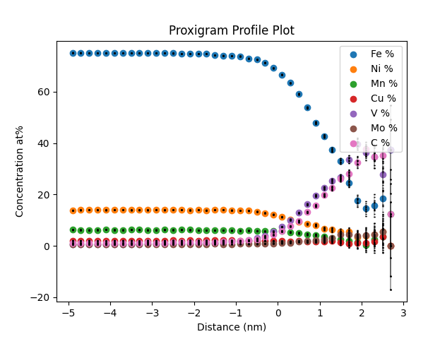
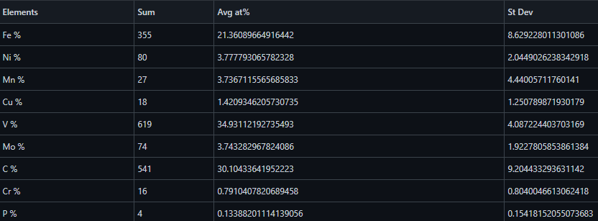
Initial Proxigram Count CSV
Manual Peak Decomposition
Proxigram Error
Modified Proxigram Count CSV
Proxigram Profile Plotter
Proxigram Percentage CSV
Proxigram Spatial Error CSV
Atom Probe Sample Core Analysis
Gibbs Interfacial Excess of Solute Calculator
Programs included in interface
Files generated for interaction
Figure 6. Programs written to interact with proxigram data

Slide 9
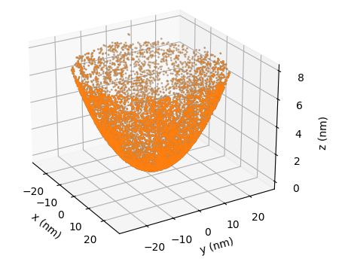
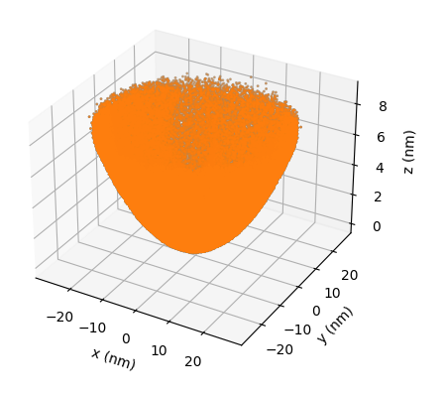
Initial .pos file
Binary to plaintext .csv processor
.csv generated from initial .pos
Programs included in interface
Cluster detection algorithm
Graphing program
Files generated for interaction
Programs in development
Average particle statistics calculator
Cluster information file
Figure 7. Programs written to interact with initial raw .pos and .epos data. A major bottleneck with interaction with .pos files is the large amounts of data, often totalling hundreds of millions of atoms to parse. Therefore, optimization and implementation of SQL along with more algorithms are a high priority to moving forward in work on .pos files. The graph is a sample of 10,000 and 100,000 atoms in a sample APT run.

Slide 10
Results
The main application interface and related programs can be found at https://github.com/sakanak/apt-csv-work
Current algorithms in the application are those written expressly for the sake of automation of manual tasks, with the exception of the calculation software for the Gibbs interfacial excess of solute
All programs were checked to have complete accuracy through comparison with past files available at the Naval Research Laboratory
The formulation used for Gibbs interfacial excess relies on estimations made for number density using an assumed lattice parameter and structure - further development could reduce such error as proposed in Krakauer & Seidman et al. (1993) for an APFIM TEM calculation of Gibbsian excess

Slide 11
Conclusions
Confirmation of the ability of toolkit to automate analysis of data in APT
Implementation of calculators for specific thermodynamic quantities
Identifiable room for development in areas dealing with large amounts of data through implementation of optimization algorithms and different data structures

Slide 12
Further Perspectives
A few tasks for the toolkit currently in development include:
Optimizing cluster detection
Generating volume and radii calculations with particle info
Executing peak detection and automatic ranging and isotope assignment using available isotope abundances table
Modelling matrix composition to track precipitation as a function of time
Additional tasks are to be determined
Further implementation of different techniques; one example includes utilizing Ripley’s K-function and machine learning to optimize the maximum separation algorithm for cluster detection, while another involves optimizing existing simulations for field evaporation such as TAPSim

Slide 13
Acknowledgements
I would like to thank Dr. Keith Knipling of the U.S. Naval Research Laboratory Materials Science and Technology Division for his incredible mentorship in offering resources as an introduction to APT, technology, procedural advice, and constant kind consideration, and guidance during this time. I would also like to thank Dr. Brian Kennedy, the director of the Chemical Analysis Laboratory at Thomas Jefferson High School for Science and Technology, for his patience and support in navigating the mentorship program at Jefferson, among other things. Additionally, I am grateful to Mr. Alfred Lampazzi, the Mentorship Program Director at Jefferson, for making this entire program possible. I have a learned a great deal over the course of this program, and am looking forward to continuing work on this project.

Slide 14
References
Reddy, S. M., Saxey, D. W., Rickard, W. D. A., Fougerouse, D., Montalvo, S. D., Verberne, R., & van Riessen, A. (2020). GGR Cutting‐Edge Review Atom Probe Tomography: Development and Application to the Geosciences. Geostandards and Geoanalytical Research. doi:10.1111/ggr.12313
Lefebvre-Ulrikson, W., Vurpillot, F. & Sauvage, X. (2016). Atom Probe Tomography. London: Academic Press.
Kelly, T. F., & Miller, M. K. (2007). Atom probe tomography. Review of Scientific Instruments, 78(3), 031101. doi:10.1063/1.2709758
Tamura, M., Shukuri, S., Moniwa, M., & Default, M. (1986). Focused ion beam gallium implantation into silicon. Applied Physics A Solids and Surfaces, 39(3), 183–190. doi:10.1007/bf00620733
Dhara, S., Marceau, R. K. W., Wood, K., Dorin, T., Timokhina, I. B., & Hodgson, P. D. (2018). Atom probe tomography data analysis procedure for precipitate and cluster identification in a Ti-Mo steel. Data in Brief, 18, 968–982. doi:10.1016/j.dib.2018.03.094
Vincent, G. B., Proudian, A. P., & Zimmerman, J. D. (2020). Three dimensional cluster analysis for atom probe tomography using Ripley’s K-function and machine learning. Ultramicroscopy, 113151. doi:10.1016/j.ultramic.2020.113151.
Kühbach, M., Breen, A., Herbig, M., & Gault, B. (2019). Building a Library of Simulated Atom Probe Data for Different Crystal Structures and Tip Orientations Using TAPSim. Microscopy and Microanalysis, 1–11. doi:10.1017/s1431927618016252
Knipling, K. E., Narayana, P. U., & Nguyen, L. T. (2017). Microstructures and Properties of As-Cast AlCrFeMnV, AlCrFeTiV, and AlCrMnTiV High Entropy Alloys. Microscopy and Microanalysis, 23(S1), 702–703. doi:10.1017/s1431927617004172
Perea, D. E., Liu, J., Bartrand, J., Dicken, Q., Thevuthasan, S. T., Browning, N. D., & Evans, J. E. (2016). Atom Probe Tomographic Mapping Directly Reveals the Atomic Distribution of Phosphorus in Resin Embedded Ferritin. Scientific Reports, 6(1). doi:10.1038/srep22321
Hellman, O. C., & Seidman, D. N. (2002). Measurement of the Gibbsian interfacial excess of solute at an interface of arbitrary geometry using three-dimensional atom probe microscopy. Materials Science and Engineering: A, 327(1), 24–28. doi:10.1016/s0921-5093(01)01885-8
Krakauer, B. W., & Seidman, D. N. (1993). Absolute atomic-scale measurements of the Gibbsian interfacial excess of solute at internal interfaces. Physical Review B, 48(9), 6724–6727. doi:10.1103/physrevb.48.6724

